Slide 1
CH7 Testing For Tradability

Slide 2
Agenda
Introduction
The linear relationship
Estimating the linear relationship: The multifactor approach
Estimating the linear relationship: The regression approach
Testing residual for tradability

Slide 3
Introduction
In this chapter :
The candidate pairs are actually tradable?
How do we decide that a pair is tradable even though it deviates from ideal conditions of cointegration ? (Use SNR )
Review properties of cointegration system :
Each individual stock series is modeled as a sum of a trend component and a stationary component.
The trend components of the two stocks must be the same.
The stationary component just oscillates about some value.
Two stock series most have strong correlation.(linear relationship!)
In regression we know that t-statistic and r-square let us to infer a strong correlation or not !
Cointegration testing is a two-step process:
Determination of the linear relationship.
Stationarity testing on the residuals.
Notes:
可買賣的Pair要共整合 但大多都不是, 我們要如何去決定一對已經偏離共整合假設的Pair的買賣?

Slide 4
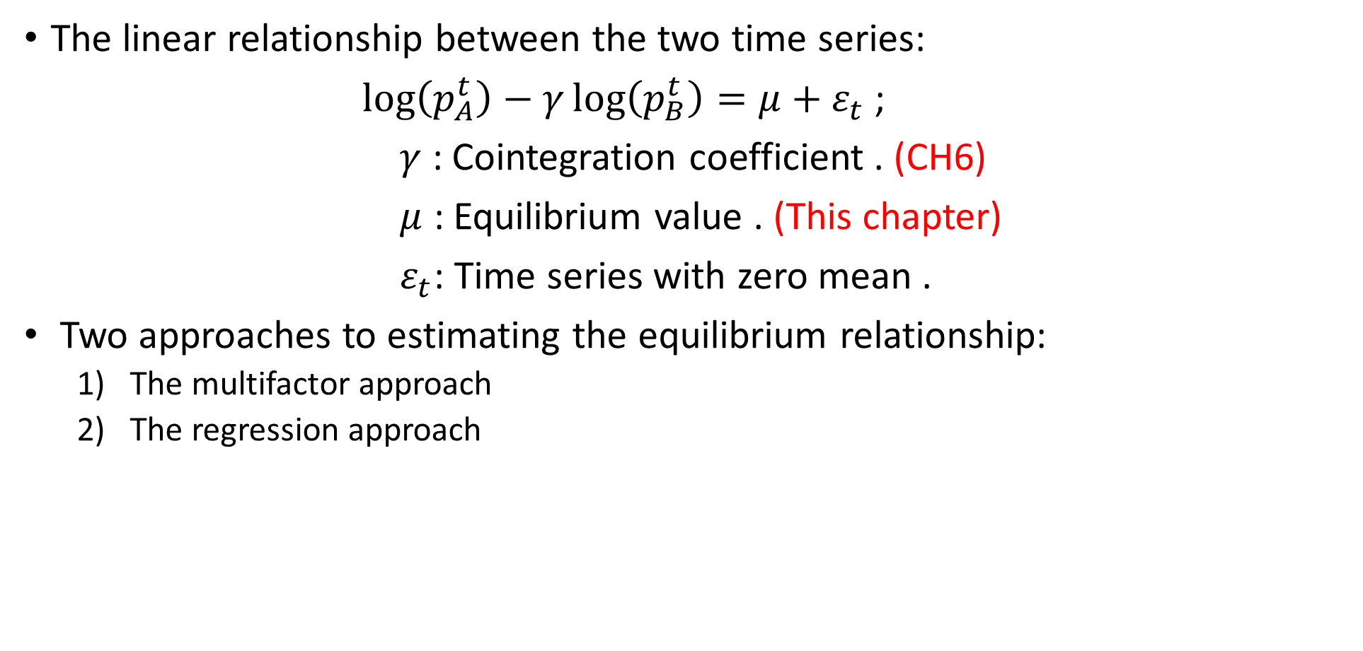
The linear relationship
The linear relationship between the two time series:
$\log\left(p_{A}^{t}\right)−γ\log\left(p_{B}^{t}\right)=μ+ε_{t}$ ;
$γ$ : Cointegration coefficient . (CH6)
$μ$ : Equilibrium value . (This chapter)
$ε_{t}$: Time series with zero mean .
Two approaches to estimating the equilibrium relationship:
The multifactor approach
The regression approach

Slide 5
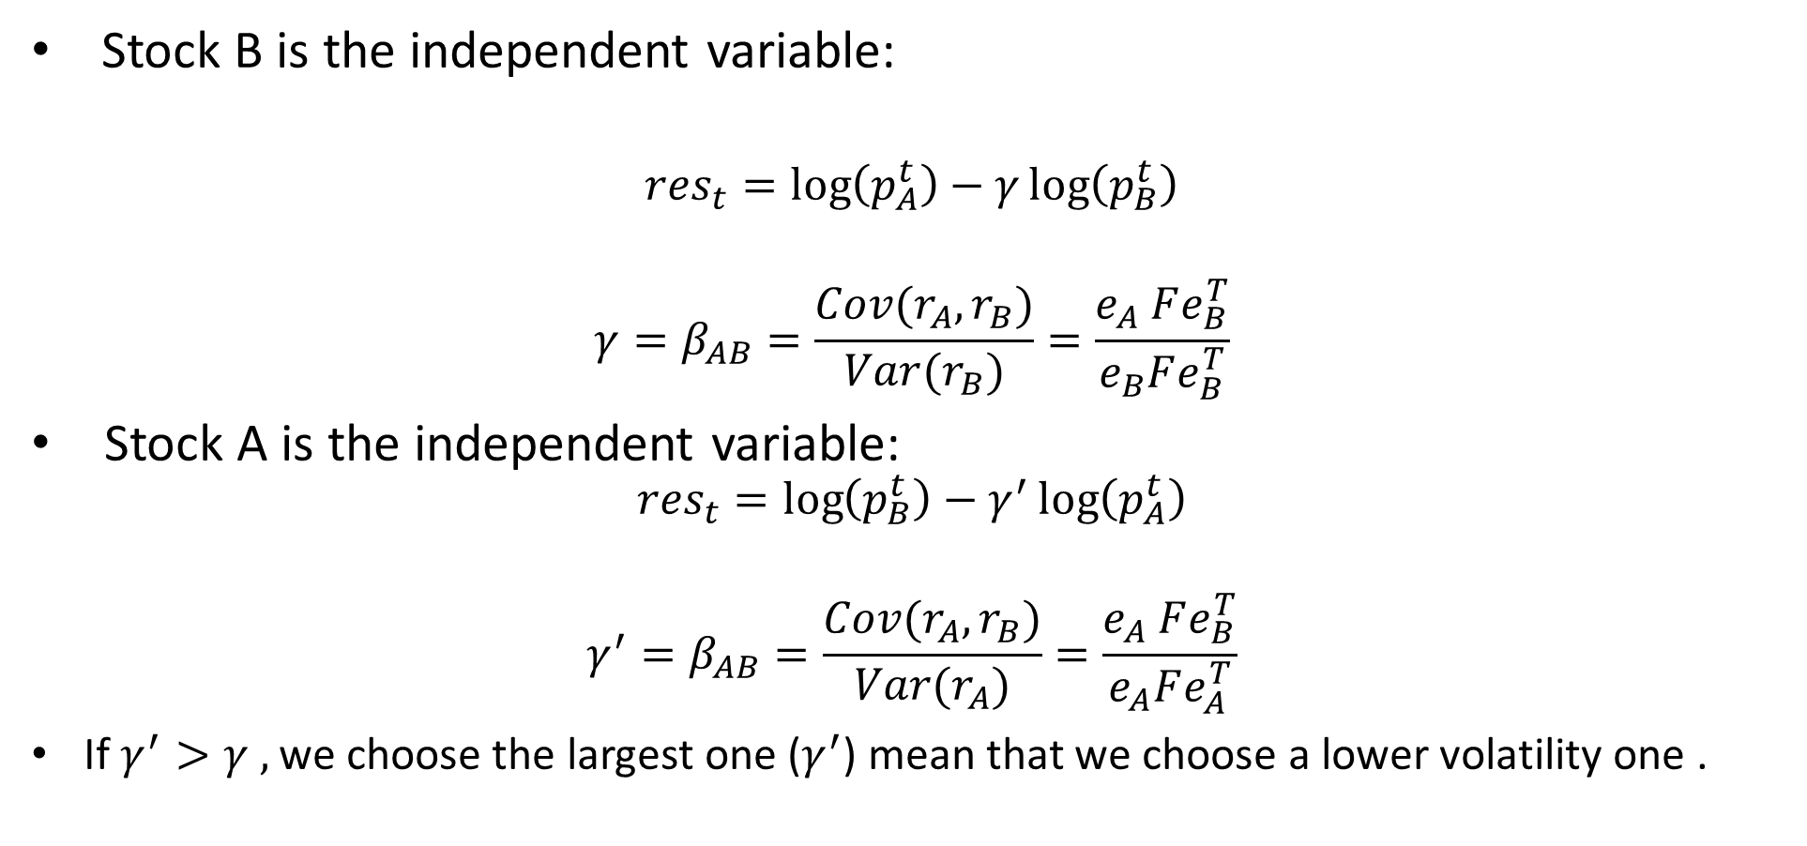
Estimating the linear relationship: The multifactor approach
Stock B is the independent variable:
$${res}_{t}=\log\left(p_{A}^{t}\right)−γ\log\left(p_{B}^{t}\right)$$
$$γ=β_{AB}=\frac{Cov(r_{A},r_{B})}{Var(r_{B})}=\frac{e_{A} Fe_{B}^{T}}{e_{B}Fe_{B}^{T}}$$
Stock A is the independent variable:
$${res}_{t}=\log\left(p_{B}^{t}\right)−γ^{′}\log\left(p_{A}^{t}\right)$$
$$γ^{′}=β_{AB}=\frac{Cov(r_{A},r_{B})}{Var(r_{A})}=\frac{e_{A} Fe_{B}^{T}}{e_{A}Fe_{A}^{T}}$$
If $γ^{′}>γ ,$ we choose the largest one ($γ^{′}$) mean that we choose a lower volatility one .

Slide 6
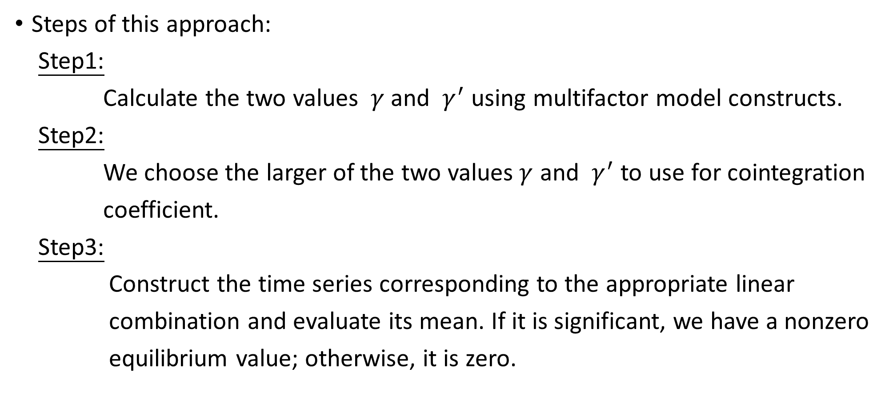
Estimating the linear relationship: The multifactor approach
Steps of this approach:
Step1:
Calculate the two values $γ$ and $γ^{′}$ using multifactor model constructs.
Step2:
We choose the larger of the two values$γ$ and $γ^{′}$ to use for cointegration
coefficient.
Step3:
Construct the time series corresponding to the appropriate linear
combination and evaluate its mean. If it is significant, we have a nonzero
equilibrium value; otherwise, it is zero.

Slide 7
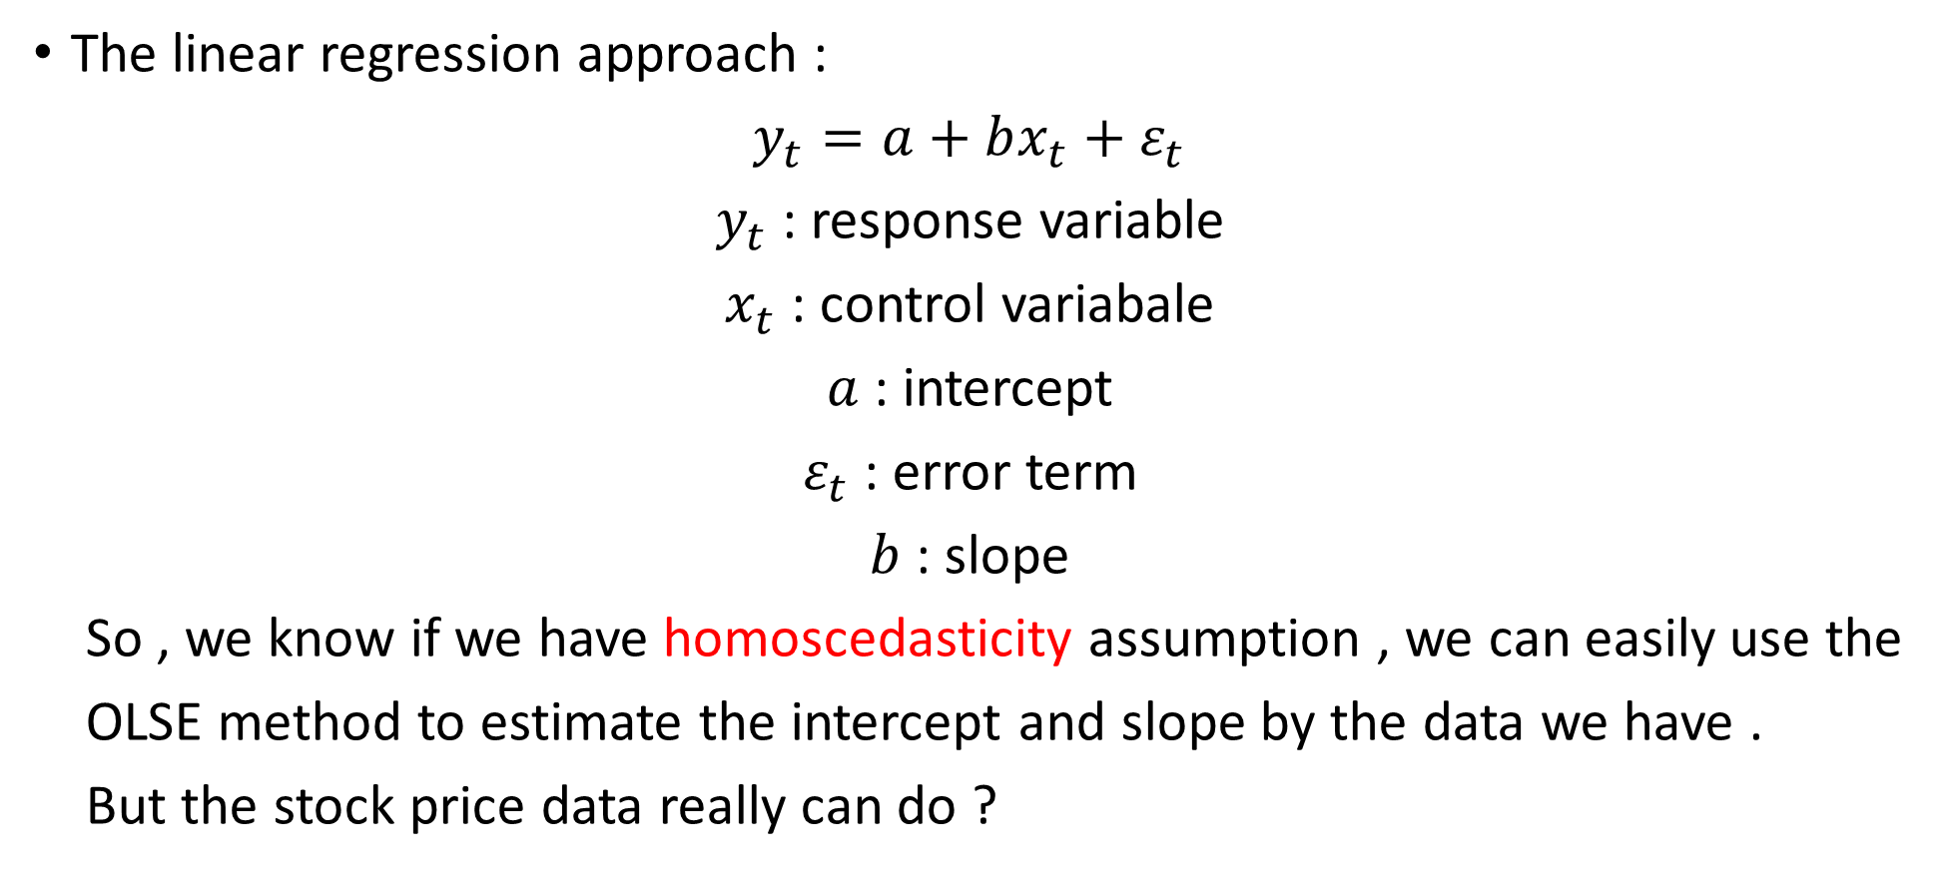
Estimating the linear relationship: The regression approach
The linear regression approach :
$y_{t}=a+bx_{t}+ε_{t}$
$y_{t}$ : response variable
$x_{t}$ : control variabale
$a$ : intercept
$ε_{t}$ : error term
$b$ : slope
So , we know if we have homoscedasticity assumption , we can easily use the
OLSE method to estimate the intercept and slope by the data we have .
But the stock price data really can do ?

Slide 8
Estimating the linear relationship: The regression approach
Let us see some problems about the stock price data :
We use just one representative value for the price in a given time period but the price change constantly.
There is no distinct separation of cause and effect.
- In CH5 , we discussed in the error correction model for cointegration.
The price values are read as outputs , so we now face two output variable . It is different from regression.
We can assert that our situation is one where the uncertainty associated with each data point is different.

Slide 9
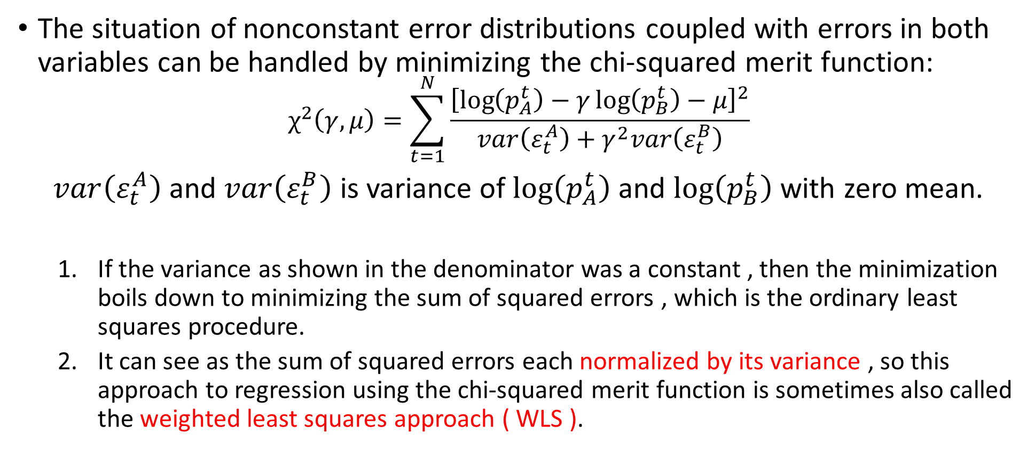
Estimating the linear relationship: The regression approach
The situation of nonconstant error distributions coupled with errors in both variables can be handled by minimizing the chi-squared merit function:
$$χ^{2}\left(γ,μ\right)=\sum_{t=1}^{N}{\frac{{\left[\log\left(p_{A}^{t}\right)−γ\log\left(p_{B}^{t}\right)−μ\right]}^{2}}{var\left(ε_{t}^{A}\right)+γ^{2}var\left(ε_{t}^{B}\right)}}$$
$var\left(ε_{t}^{A}\right)$ and $var\left(ε_{t}^{B}\right)$ is variance of $\log\left(p_{A}^{t}\right)$ and $\log\left(p_{B}^{t}\right)$ with zero mean.
If the variance as shown in the denominator was a constant , then the minimization boils down to minimizing the sum of squared errors , which is the ordinary least squares procedure.
It can see as the sum of squared errors each normalized by its variance , so this approach to regression using the chi-squared merit function is sometimes also called the weighted least squares approach ( WLS ).

Slide 10
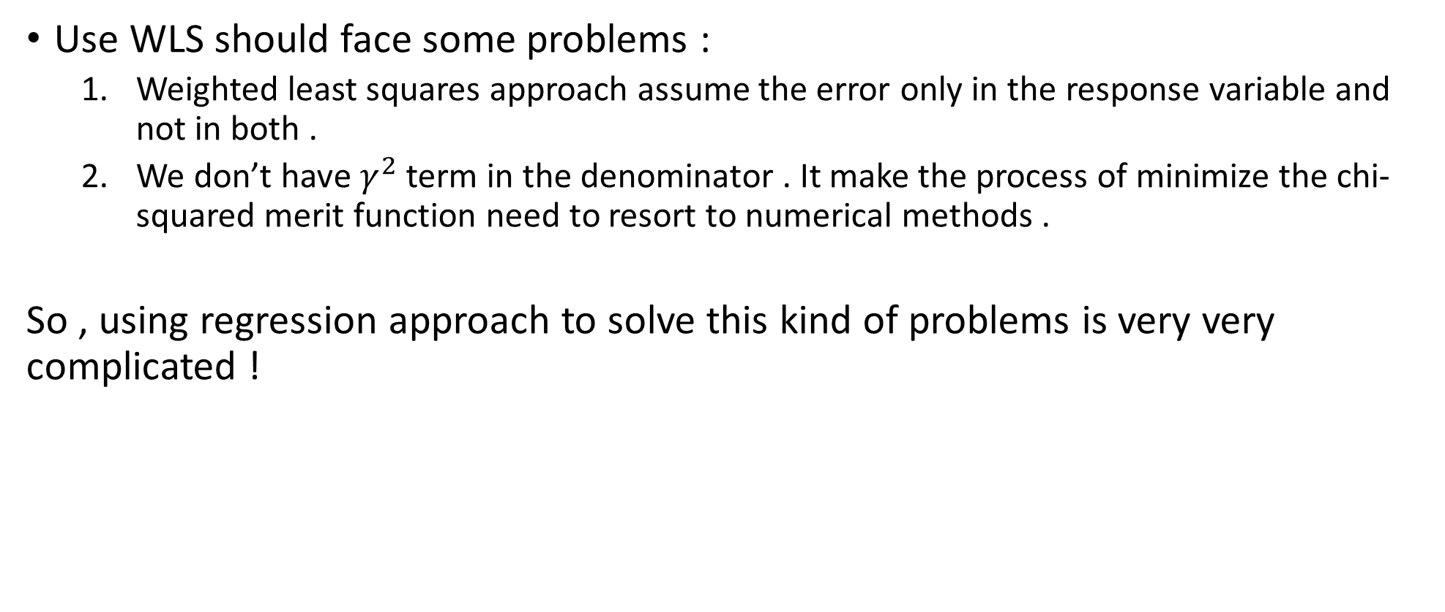
Estimating the linear relationship: The regression approach
Use WLS should face some problems :
Weighted least squares approach assume the error only in the response variable and not in both .
We don’t have $γ^{2}$ term in the denominator . It make the process of minimize the chi-squared merit function need to resort to numerical methods .
So , using regression approach to solve this kind of problems is very very complicated !

Slide 11
Testing residual for tradability
In an ideal situation for tradability , the two stocks would be cointegrated , and the residual series would be stationary .
Mean reversion.
So It would therefore be nice if we could quantify the degree of mean
reversion of a given time series.
The frequency of zero-crossing is then the number of times we can expect the
time series to cross its equilibrium value in unit time.
- Time of mean reversion more short -> Time of holding position more short.
It turns out that highly mean-reverting series are also characterized by a
high frequency of zero-crossings.
Notes:
可買賣的Pair要共整合 但大多都不是, 我們要如何去決定一對已經偏離共整合假設的Pair的買賣?

Slide 12
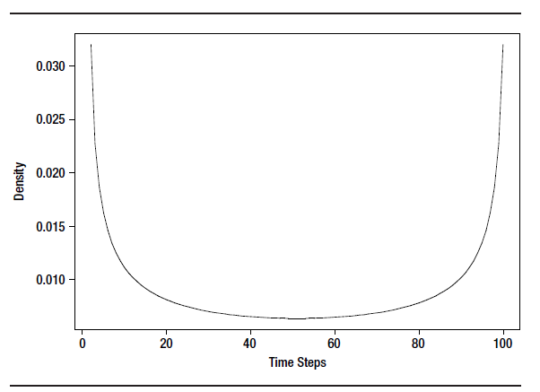

Testing residual for tradability
How to explain Zero-crossing ?
Arcsine law : (P. Levy)
$P\left(g<u\right)=\frac{2}{π}arcsine(\sqrt{\frac{u}{T}} )$ with pdf $P\left(u\right)=\frac{1}{π}\frac{1}{\sqrt{u(T−u)}}$
1. T : stop time of the series
g : the last time when zero is visited
2. we expect the zero crossing to have
occurred with high probability only at
the extremes of the time interval.
Notes:
可買賣的Pair要共整合 但大多都不是, 我們要如何去決定一對已經偏離共整合假設的Pair的買賣?

Slide 13
Testing residual for tradability
Direct method (this book tell us):
1. First, we get the sample small size population of time between crossings
by counting the time between subsequent crossings in the residual series.
2. A probability distribution is then constructed by resampling repeatedly
from the existing sample. The large sample obtained as a result of the
resampling exercise is then used to construct the probability distribution.
(Bootstrap method)
3. Percentile levels may then be constructed for the population. We can
then check to see if the rates at the desired percentile levels on either side
of the median satisfy our trading requirements. If they do, then we declare
the pair tradable and vice versa.
Notes:
可買賣的Pair要共整合 但大多都不是, 我們要如何去決定一對已經偏離共整合假設的Pair的買賣?

Slide 14
Testing residual for tradability
Example :
Step 1 :
Choose two stocks from the semiconductor sector and sampled their
prices as of the day’s close for 90 days.
Step 2 :
Run an ordinary least squares method on it two times,changing the
independent variable.
- Equilibrium value μ = –0.6971
- Cointegration coefficient γ = 1.0617
R-squared from the regression is 0.7965
Notes:
可買賣的Pair要共整合 但大多都不是, 我們要如何去決定一對已經偏離共整合假設的Pair的買賣?

Slide 15
Testing residual for tradability
Example :
Step 1 :
Choose two stocks from the semiconductor sector and sampled their
prices as of the day’s close for 90 days.
Step 2 :
Run an ordinary least squares method on it two times,changing the
independent variable.
- Equilibrium value μ = –0.6971
- Cointegration coefficient γ = 1.0617
R-squared from the regression is 0.7965
Notes:
可買賣的Pair要共整合 但大多都不是, 我們要如何去決定一對已經偏離共整合假設的Pair的買賣?

Slide 16
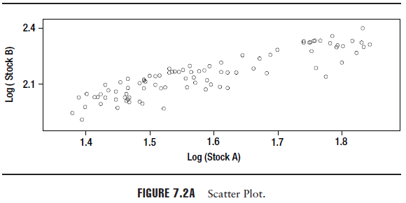
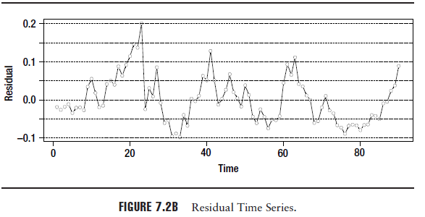
Testing residual for tradability
Run the bootstrap procedure on residual.
If the time between zero crossings can be as long as
14 to 26 days with a median value of about 5 days.
The pair definitely seems to be in tradable category.
Notes:
可買賣的Pair要共整合 但大多都不是, 我們要如何去決定一對已經偏離共整合假設的Pair的買賣?

Slide 17

Some problem of this chapter
Why we need to select the largest$γ$ ? Short a lower volatility one ?
Does log of price can operate directly ?
Notes:
可買賣的Pair要共整合 但大多都不是, 我們要如何去決定一對已經偏離共整合假設的Pair的買賣?

